Slide 1
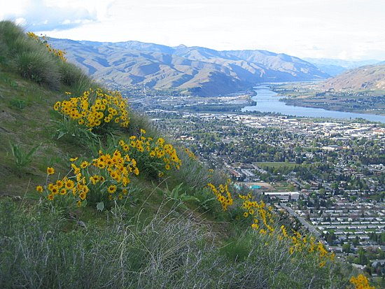
Improving survival from out of hospital cardiac arrest in Chelan and Douglas Counties
May 2019 progress report on key performance indicators at RiverCom
Lance W. Jobe, MD FACEP
Medical Program Director,
Emergency Medical Services

Slide 2
330,000
die from cardiac arrest in the US each year, making it a leading cause of death
Only about 10% survive a cardiac arrest event

Slide 3
Utstein Criteria
Broad categories of cardiac arrest
Ventricular fibrillation or pulseless ventricular tachycardia (VF)
Pulseless electrical activity (PEA)
Asystole (flat line)
Was it witnessed?
Utstein criteria
Witnessed VF arrest
National survival = 33%

Slide 4
Rhythm Test…

Slide 5
100%
90%
80%
Bystander CPR
70%
Survival
60%
High Performance
Professional CPR
50%
40%
30%
20%
10%
1
2
3
4
5
6
7
8
9
10
Time

Slide 6
Rate of Dispatcher Assisted CPR in Chelan & Douglas Counties

Slide 7
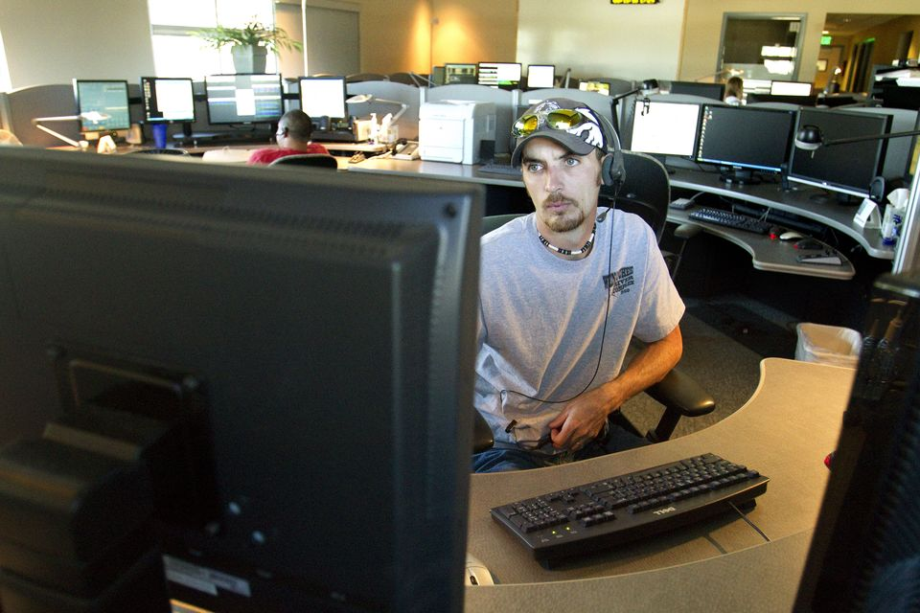
Telephone CPR
Percent Meeting Goal
Cardiac Arrest Metrics
Percent recognition of arrest
Percent compressions initiated
Time to dispatch
Time to recognition of cardiac arrest
Time to CPR
Notes:
1:20

Slide 8
Telephone CPR Metrics
Seconds
* Times represent the median
** Time from address verification
Notes:
Time to address 22s to 18
Dispatch 31 s to 25
Recognition 41s to 42
Compressions 140s to 119
AREA TO IMPROVE: NEED T0 SHARE DATA WITH OTHER AGENCIES
1:35

Slide 9
3-year Aggregate Utstein Survival
Chelan & Douglas Counties
53%
47%
45%
42%
38%
30%*
*
*2010 data from retrospective review

Slide 10
57%
39%
Aggressive t-CPR
Call Taker QI process
Rapid Dispatch

